Slide 1
Computer-System Structures
Computer System Operation
I/O Structure
Storage Structure
Storage Hierarchy
Hardware Protection
General System Architecture

Slide 2
Computer-System Operation
A modern computer system consists of a CPU, memory, system bus and a number of device controllers
I/O devices and the CPU can execute concurrently.
Each device controller is in charge of a particular device type.
A device controller for each device which contains local buffer storage and special purpose registers
A bootstrap program is required to initialize the computer system
CPU moves data from/to main memory to/from local buffers
I/O is from the device to local buffer of controller.
Device controller informs CPU that it has finished its operation by causing an interrupt.

Slide 3

Computer-System Architecture

Slide 4
Common Functions of Interrupts
The occurrence of an event is usually signaled by an interrupt from either the hardware or the software
System call or monitor call is executed to trigger an interrupt
Interrupt transfers control to the interrupt service routine generally, through the interrupt vector, which contains the addresses of all the service routines.
Interrupt architecture must save the address of the interrupted instruction.
Incoming interrupts are disabled while another interrupt is being processed to prevent a lost interrupt.
A trap is a software-generated interrupt caused either by an error or a user request.
An operating system is interrupt driven and priority interrupts have been introduced in modern systems,

Slide 5
Interrupt Handling
When the CPU is interrupted, it stops what it is doing and immediately transfers execution to a fix location to execute the interrupt service routine through a table of pointers which is stored in LMA (Logical Memory Address)
On completion of execution of service routine, the CPU resumes the interrupted computation
LMA locations hold the addresses of the interrupt service routines (interrupt vector) for the various devices
Separate segments of code determine what action should be taken for each type of interrupt
The operating system preserves the state of the CPU by storing registers and the program counter.
Determines which type of interrupt has occurred:
  polling
  vectored interrupt system
Interrupts are an important part of a modern computer system and they must be handled quickly
System call is the method used by a process to request action by the operating system

Slide 6
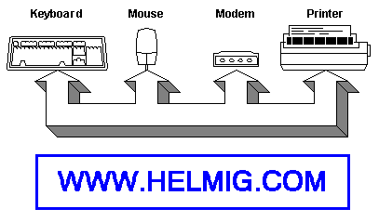
Polling
The CPU stops in regular interval to process the user-program to check now with EVERY connected device, if an action of the CPU is required.
This is a very ineffective method, since this checking takes up substantial processing time.

Slide 7
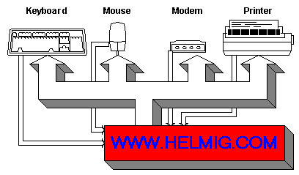
Interrupts
Much more efficient is the method to assign to each device a "ringer".
This allows the CPU to continuously process the User-Program. If a device needs now to be handles, it uses the "ringer" to send an alarm system to the CPU. The CPU interrupts now its current activity and handles the request of the interrupting device.

Slide 8
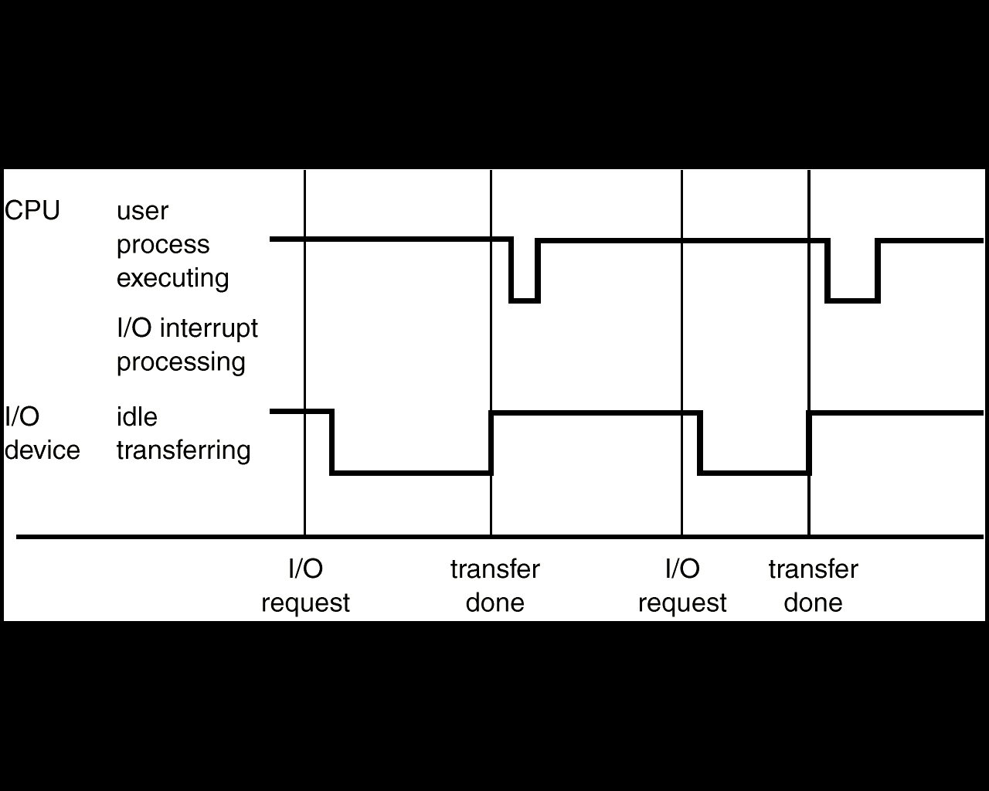
Interrupt time line for a single process doing output

Slide 9
Interrupts
An interrupt is a signal to the CPU from some other module in the system.
  For example, when an I/O operation completes, the I/O module will interrupt.
The CPU will then interrupt its normal flow of control to process the interrupt.
Interrupts improve CPU efficiency.
  The following example illustrates why.

Slide 10
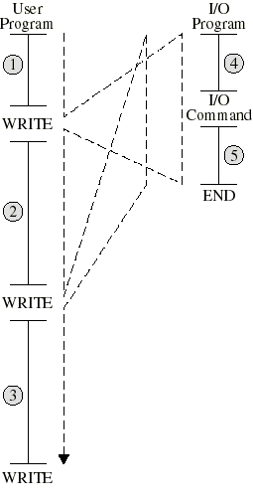
Control Flow Without Interrupts
User program runs (1) until WRITE instruction transfers control to the I/O program.
I/O program prepares I/O module for printing (4).
CPU waits for I/O command to complete, which may take a long time.
I/O program finishes in (5) and report status of operation.
User program resumes executing (until next WRITE).

Slide 11
Why Interrupts are Needed
In the previous example, the CPU has to wait for I/O to complete.
It would be more efficient if the processor could continue to execute instructions while the device executes in parallel.
Interrupts make this possible.

Slide 12
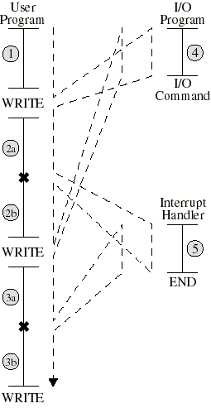
Control Flow with Interrupts
User program executes WRITE. Control branches to an I/O program,which issues the I/O command. (4)
I/O program returns control to user application
User code executes during I/O operation… no waiting
User program interrupted (x) when I/O operation is done. CPU branches to interrupt handler
(2b) Execution of user code resumes

Slide 13
Interrupt Processing
Interrupt processing comes at unpredictable points in program execution.
The interrupted program must not be affected, so its state must be temporarily saved and later restored

Slide 14
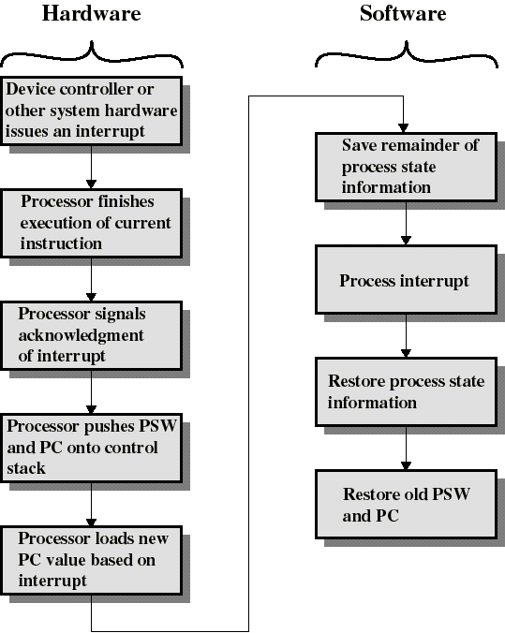
Interrupt Processing
Hardware steps are automatic; details vary slightly according to CPU architecture.
Software steps save process state, handle the interrupt (exact details depend on nature of interrupt), restore state.
Interrupts allow devices and CPU to run in parallel.
*PSW(Program status word)

Slide 15
Types of Interrupt
There are four main types of interrupts:
I/O Interrupts.
Program Interrupts.
Hardware Interrupts.
Timer Interrupts.

Slide 16
Timer interrupts
Timer interrupts are classed as "external" and help to determine how long a given process has been running. The system timer has the highest (internal) priority, at IRQ0.

Slide 17
I/O interrupts
I/O interrupts assist in the operation of external devices. A hard drive controller can signal the completion of a write/read operation, so that it can be given more operations to carry out. A COM port can signal I/O activity by an attached Modem or Mouse.

Slide 18
Program interrupts
Program (also known as "internal") interrupts are generated by user processes. They are generated when a user programs are in error (divide by zero, trying to access the memory space occupied by the Operating System Kernel, etc).

Slide 19
Hardware interrupts
Hardware (or "external") interrupts are either maskable or non-maskable. Maskable interrupts can be disabled, non-maskable may not. They are generated if critical hardware errors are encountered. Faulty RAM; Hard Drive crashes can signal hardware interrupts.

Slide 20
Critical Events
Events critical to the operation of a program (e.g. a mouse click, key pressed) are signaled by interrupts. When such an event occurs, the appropriate interrupt is flagged and detected by the CPU, which can pass control to the appropriate handler. The CPU can then resume it's previous task.

Slide 21
The Hierarchy
Each interrupt is part of a hierarchy; some are more important than others.
For example: a COM port should always take precedence over a sound card, due to the heavy use of a mouse in a GUI. This helps to ensure that there will be no "deadlocks," that is: no two interrupts can have the same priority.

Slide 22
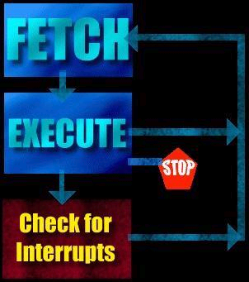
Instruction Execution Cycle of an Interrupt System
Any system that uses interrupts must include a section in it's Instruction Execution Cycle to detect when an interrupt has been signaled.

Slide 23
What Happens When an Interrupt is Generated?

Slide 24
Categories if Interrupts
Interrupts fall into two major categories:
maskable
non-maskable.
An interrupt may be either EDGE or LEVEL sensitive.

Slide 25
Edge level interrupts
Edge level interrupts are recognized on the falling or rising edge of the input signal. They are generally used for high priority interrupts and are latched internally inside the processor. If this latching was not done, the processor could easily miss the falling edge (due to its short duration) and thus not respond to the interrupt request.

Slide 26
Level sensitive interrupts
Level sensitive interrupts overcome the problem of latching, in that the requesting device holds the interrupt line at a specified logic state (normally logic zero) till the processor acknowledges the interrupt. This type of interrupt can be shared by other devices in a wired or configuration, thus is commonly used to support daisy chaining and other techniques.

Slide 27
Maskable Interrupts
The processor can inhibit certain types of interrupts by use of a special interrupt mask bit. This mask bit is part of the condition code register, or a special interrupt register. If this bit is set, and an interrupt request occurs on the Interrupt Request input, it is ignored.

Slide 28
Non-Maskable Interrupts
There are some interrupts which cannot be masked out or ignored by the processor. These are associated with high priority tasks which cannot be ignored (like memory parity or bus faults). In general, most processors support the Non-Maskable Interrupt (NMI). This interrupt has absolute priority, and when it occurs, the processor will finish the current memory cycle, then branch to a special routine written to handle the interrupt request.

Slide 29
A step-by-step study
Timer / I/O Device / Program / Hardware raises an interrupt. This flag has a value, indicating it's priority.
CPU finishes execution of the current instruction, and searches for raised interrupts.
If there are multiple interrupts raised, the one with the highest priority is chosen, thus avoiding a deadlock.
The information currently in the registers, and the Processor Status Word (PSW) is stored on the stack. Execution is passed to the appropriate handler.
If another interrupt is encountered at the end of the Processor Instruction Cycle, which has a higher priority than the one currently being handled, the information currently in the registers, and the PSW is stored on the stack. Execution is passed to the appropriate handler... and on until the interrupt handler completes it's execution.
The PSW and other data is restored to the CPU registers, and execution of the previous process can continue.

Slide 30
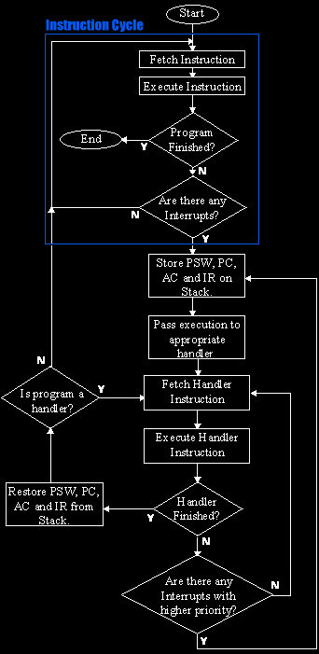

Slide 31
The Use of Interrupts
The use of interrupts generally falls into the following categories,
Input/Output data transfers for peripheral devices
Input signals to be used for timing purposes
Emergency situations (power-down)
Real-Time-execution/Multitasking
Event driven programs

Slide 32
Basic Steps
The Basic steps involved in interrupt processing are:
Getting signal.
Saving Current Status.
Determining Who Signaled and What To Do About It.
Returning to original activity.

Slide 33
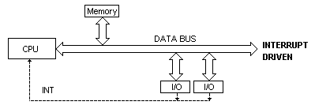
Interrupt Controlled I/O Transfers

Slide 34
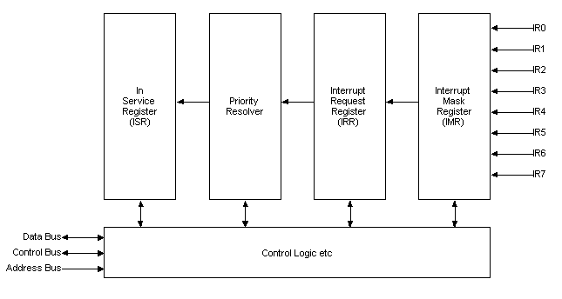
The Programmable Interrupt Controller

Slide 35
Cause of an Interrupt
In general, two methods are used to determine what condition is causing an interrupt:
Examination of the device status word
Examination of the interrupt-level status word
Interrupt Latency
The interrupt latency is the interval of time measured from the instant an interrupt is asserted until the corresponding ISR begins to execute.
Interrupt Response Time
The time interval between the CPU recognizing the interrupt to the time when the first instruction of the interrupt service routine is executed.

Slide 36
I/O Structure
The computer system has a number of device controllers connected through a common bus
A device controller contains local buffer storage and a set of special purpose registers
The device driver is responsible for moving the data between the peripheral devices and it controls its local buffer storage
I/O interrupts are used by the device controllers for transfer of data
I/O methods:
  Synchronous
  Asynchronous
In synchronous method, after I/O starts, control returns to user program only upon I/O completion.
  Waiting for I/O may be accomplished by either wait instruction or wait loop
  Wait instruction idles the CPU until the next interrupt
  Wait loop continuous until an interrupt occurs
  At most one I/O request is outstanding at a time, no simultaneous I/O processing.

Slide 37
I/O Structure
In asynchronous method, after I/O starts, control returns to user program without waiting for I/O completion. It requires:-
  System call – request to the operating system to allow user to wait for I/O completion.
  Device-status table contains entry for each I/O device indicating its type, address, and state.
  Operating system indexes into I/O device table to determine device status and to modify table entry to include interrupt.
  OS will also maintain a wait queue for each I/O device.
  An I/O device interrupts when it needs service, OS determines I/O device and updates its table entry
  An interrupt signals completion of an I/O request, control then returns from I/O interrupt to another request or user program
  Interrupt schemes vary from system to system
  This method increases system efficiency

Slide 38

Two I/O Methods
Synchronous
Asynchronous

Slide 39

Device-Status Table

Slide 40
Direct Memory Access Structure
Involvement of CPU in data transfer is a time-consuming process. If the CPU needs two microseconds to respond to each interrupt and interrupts arrive every four microseconds then less time is left for process execution.
DMA is used for high-speed I/O devices able to transmit information at close to memory speeds.
Device controller transfers blocks of data from buffer storage directly to main memory without CPU intervention.
Only one interrupt is generated per block, rather than the one interrupt per byte.

Slide 41
Direct Memory Access Structure
DMA controller has its own registers for source and destination addresses
A device driver sets the DMA controller registers to use the appropriate source and destination addresses, transfer length and it is then instructed to starts I/O operation
While the DMA controller is performing the data transfer, the CPU is free to perform other tasks
As the DMA controller steals memory cycles from the CPU so it slows down CPU execution during DMA operation
DMA interrupts the CPU when the transfer has been completed

Slide 42
Issue Read
command to
I/O Module
CPU --> I/O
Issue Read
command to
I/O Module
CPU --> I/O
Issue Read
Block Command
to I/O Module
CPU--> DMA
Do something
else
Do something
else
Read Status
of I/O
Module
Read Status
of I/O
Module
Interpret
I/O --> CPU
I/O --> CPU
Not
ready
Read Status
of DMA
Module
Interpret
Check
status
Error
Condition
Check
status
Error
Condition
ready
DMA --> CPU
Read word
from I/O
Module
Read word
from I/O
Module
I/O --> CPU
I/O --> CPU
Next Instruction
(c) direct memory access
Write Word
Into Memory
Write Word
Into Memory
CPU --> Memory
CPU --> Memory
No
Done?
No
Done?
yes
yes
Next Instruction
(a) Programmed I/O
Next Instruction
(b) Interrupt-driven I/O
FIGURE : Three techniques for input of a block of data

Slide 43
Storage Structure
Registers
Cache
Main Memory
Electronic Disk
Magnetic Disk
Optical Disk
Hard Disk
Magnetic Tape

Slide 44
Registers
Registers are available in the CPU and are accessible within one cycle of the CPU clock.
Faster operations are carried out on contents of CPU registers due to faster accesses.
Processor does not stall while performing operations on registers.
Size of the registers is very small.
Registers are volatile.

Slide 45
Cache
CPU needs to stall as RAM is slower than CPU speed for providing data required to complete the instruction.
Cache is a faster memory between the CPU and main memory and is a remedial measure to reduce idling time of CPU.
Cache is a memory buffer which stores information required by the CPU using register-allocation and register-replacement algorithms.
Instruction cache holds the next instruction expected to be executed whereas data cache keeps required data for the instruction t. They are known as hardware caches.
Cache have limited size so cache management is a problem for designers.
Careful selection of the cache size and of a replacement algorithm can provide 80 – 99% of all accesses within the cache – maximizing system performance.
Caches are volatile.

Slide 46
Main Memory
Main memory can be viewed as a fast cache for secondary storage.
Programs must be loaded in the RAM for execution and main memory is a large storage media that the CPU can access directly.
Main memory is implemented in a semiconductor technology (DRAM).
Load and store instructions specify memory addresses for interaction.
A typical instruction is executed using fetch-decode-execute cycle.
All programs and data can not be stored in a RAM because of its small size and volatility.
Special I/O instructions allow data transfers between the device controller registers and main memory.
In memory-mapped I/O, ranges of memory addresses are set aside and are mapped to the device registers for providing more convenient access to I/O devices.
In programmed I/O, CPU uses polling to watch the bit in the control register to see whether the device is ready for transfer of data between device and main memory.
In an interrupt-driven I/O, CPU receives an interrupt when the device is ready for the data transfer.

Slide 47
Magnetic Disks
Magnetic disks provide a large space for storing programs and data on permanent basis.
Disks are relatively simple and consist of:
  Platters covered with the magnetic material
  Read-write head
  Disk arm
  Each surface of platter has tracks, sectors and cylinders
Disk speed depends upon Transfer rate and positioning time (seek time & rotational latency)
Head crash damages the magnetic surface and the entire disk is replaced for safety of data and programs.
The storage size of a HD is in GBs.
FDD rotates slowly than HDD which reduces wear on the disk surface. Its storage capacity is very small compare to HD or CD.
Buses attached to a disk drive are EIDE, ATA and SCSI.
Data transfer through a bus is carried out between the host controller and disk controller.
Magnetic disks are non-volatile.

Slide 48

Moving-Head Disk Mechanism

Slide 49
Magnetic Tapes
Magnetic tapes are used to backup the data and programs in order to protect any loss due to HD failure.
Magnetic tapes can hold large quantities of data / programs.
Access time is too slow compared to HD, CD, Main Memory etc.
Magnetic tapes are non-volatile.
Storage / handling of magnetic tapes requires special care.
Recording / reading of information is very slow due to winding / rewinding of tapes.
Random access is not available on tapes.

Slide 50
Storage Hierarchy
Storage systems can be organized in a hierarchy according to:
  Speed
  Cost
  Capacity
  Volatility
Registers, cache and memory are constructed using semiconductor memory and are volatile.
Electronic disks can be volatile or nonvolatile.
All secondary storage devices (magnetic disk, optical disk, floppy disk, magnetic tapes, magnetic drums etc) are nonvolatile.

Slide 51

Storage-Device Hierarchy

Slide 52
Coherency and Consistency
The same data may appear in different levels of the storage system. For example, value of variable (X) of file G may reside on magnetic disk, main memory, cache or CPU registers.
In a multitasking environment, each process wishing to use the value of variable (X) must obtain the most recently updated value.
A copy of variable (X) may exist simultaneously in several caches having different value in a multiprocessor environment. For cache coherency, system hardware must make sure that an update to value of X in one cache is immediately reflected in all other caches where X resides for concurrent execution of file G.
For cache consistency in a distributed environment, the various replicas of the file G may be accessed and updated concurrently so system must ensure that when a replica is updated in one computer, all other replicas are brought up-to-date quickly through client or server initiated approach.

Slide 53
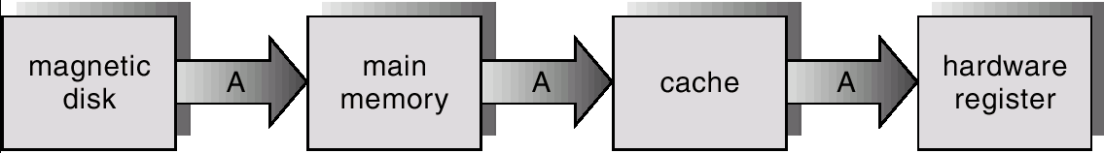
Migration of X From Disk to Register
X
X
X

Slide 54
Hardware Protection
Dual-Mode Operation
I/O Protection
Memory Protection
CPU Protection

Slide 55
DUAL MODE OPERATION
Sharing of system resources improved CPU utilization but increased problems. Many jobs could be affected by a bug in one program.
A good OS must ensure that a faulty program cannot cause other programs to execute incorrectly.
If a user program fails, the hardware will trap to OS, the OS dumps the memory of the program for debugging and terminates it.
The hardware-supported dual-mode operation protects the OS, all other programs and their data from any malfunctioning program.
  User-mode of operation (mode-bit is 1).
  Monitor/supervisor/system mode of operation (mode-bit is 0).
Whenever an interrupt or trap occurs, the hardware switches from user-mode to monitor-mode. OS is in the monitor-mode.

Slide 56
Dual-Mode Operation
The dual-mode of operation provides us with the means for protecting the OS from errant users and errant users from one another.
The hardware allows privileged instructions (e.g. system call) to be executed only in monitor mode.
When an interrupt or fault occurs hardware switches to monitor mode.
Interrupt/fault
monitor
user
set user mode

Slide 57
I/O Protection
All I/O instructions are defined as privileged instructions so users cannot issue I/O instructions from user mode.
Must ensure that a user program could never gain control of the computer in monitor mode (i.e., a user program that, as part of its execution, stores a new address in the interrupt vector).
To do I/O, a user programme executes a system call to request that the OS perform I/O on its behalf and returns the control to the users after completion of I/O operation.

Slide 58

Use of a System Call to Perform I/O

Slide 59
Memory Protection
Must provide memory protection for the interrupt vector, the interrupt service routines and user programs from one another.
In order to have memory protection, two registers are used to determine the range of legal addresses a program may access:
  Base register – holds the smallest legal physical memory address.
  Limit register – contains the size of the range
Memory outside the defined range is protected.
A trap is generated if any user’s program attempts to access unauthorized memory area.
When executing in monitor mode, the operating system has unrestricted access to both monitor and user’s memory.
The load instructions for the base and limit registers are privileged instructions.

Slide 60

Use of a Base and Limit Register

Slide 61

Hardware Address Protection

Slide 62
CPU Protection
A user program may:
  be stuck in an infinite loop
  fail to call system services
  fail to return control to the OS
Timer – interrupts computer after specified period to ensure operating system maintains control.
  Timer is decremented every clock tick.
  When timer reaches the value 0, an interrupt occurs and control is automatically transferred to the OS.
Timer is also commonly used to implement time sharing mechanism.
Time can be used to compute the current time.
Load-timer is a privileged instruction.

Slide 63
Network Structure
Local Area Networks (LAN)
  LANs were introduced in 1970 for economical use of a number of small computers and sharing of computer resources.
  LANs cover a small geographical area and are generally used in an office environment.
  Communication links of LANs have a higher speed and lower error rate.
  High-quality cables (TP, Fiber Optic etc) are used for establishment of LANs.
  Common topologies are bus, ring and star.
  Communications speed range from Mbps to Gbps.
  A typical LAN may consist of PCs/Laptops/PDAs, shared peripheral devices and one or more gateways.

Slide 64
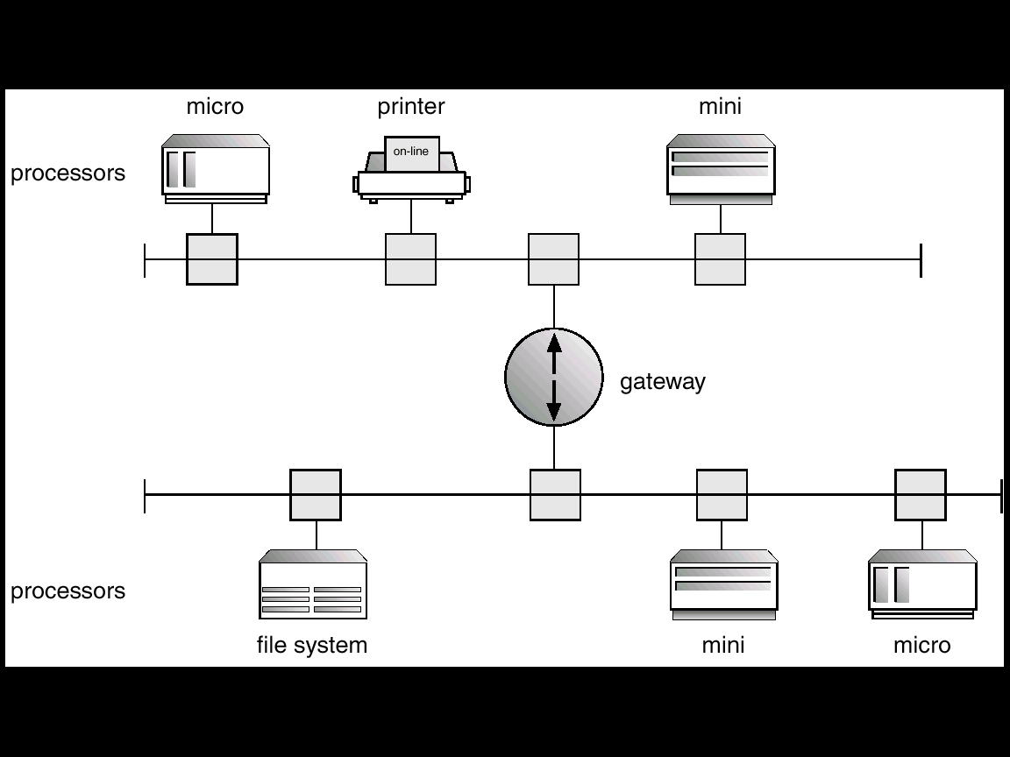
Local Area Network Structure

Slide 65
Network Structure
Wide Area Networks (WAN)
  WANs emerged in the late 1960s to provide efficient communication among sites.
  WANs are physically distributed over a large geographical area.
  Hardware and software resources are shared conveniently and economically by a wide community of users.
  ARPANet grew from four sites to millions of sites using internet.
  The communication links (telephone lines, leased lines, microwave links, satellite channels etc) are relatively slow and less reliable.
  Communication processors control the communication links for transferring information among the various sites.
  The internet WAN provide the ability for hosts at geographically separated sites to communicate with one another.
  The host computers differ from each other in type, speed, word length, operating system etc.
  Connections between networks use a telephone-system service to provide communication:
    T1 service provides a transfer rate of 1.544 Mbps
    T2 service provides a transfer rate of 6.312 Mbps
    T3 service provides a transfer rate of 44.736 Mbps
    T4 service provides a transfer rate of 274.176 Mbps

Slide 66
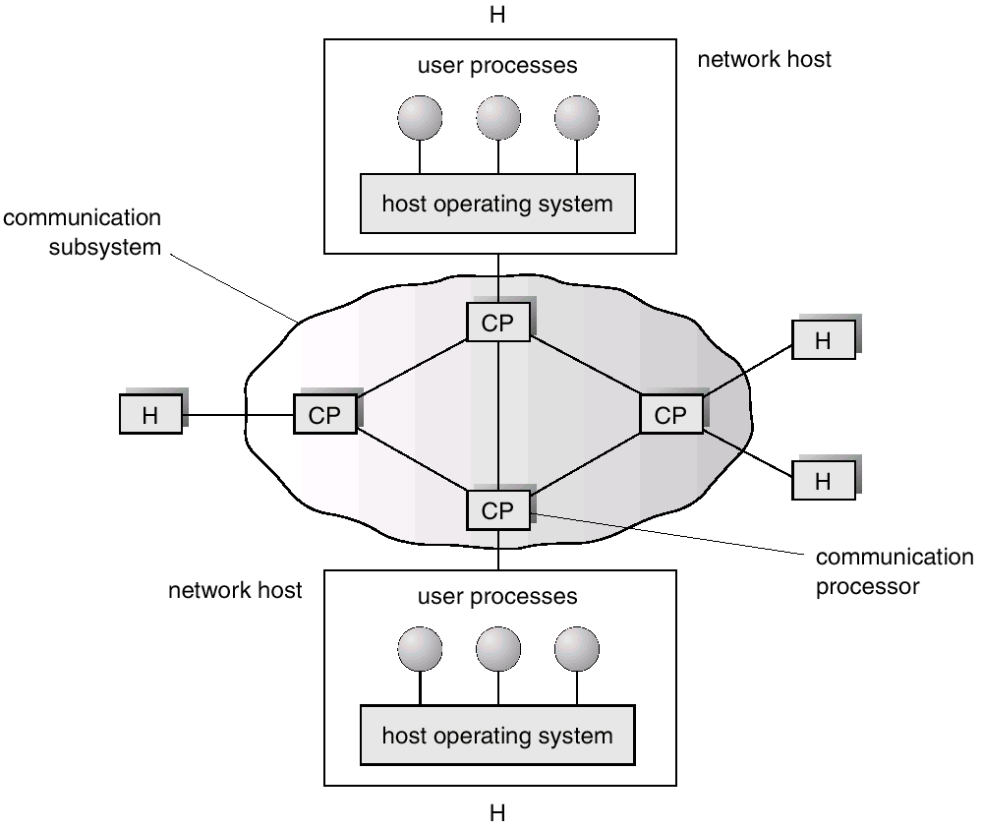
Wide Area Network Structure
  The router control the path each message takes through the net. Dynamic routing enhances communication efficiency whereas static routing reduces security risks.
  Modems convert digital data to analog signals and vice versa for communication.
  WANs are slower than LANs (1200 bps to 1 Mbps) and uses PPP for connecting computers to the internet.

